Slide 1
Bioinformatic Analysis of Nucleic-Acid Sequences
Md Mazedul Haq

Slide 2
Contents
Sequencing
Regulatory region analysis
Open Reading Frame
Single Nucleotide Polymorphisms (SNPs)

Slide 3
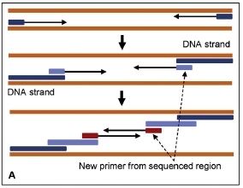
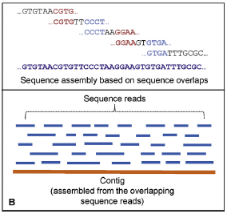
Sequencing Strategy
A) Directed DNA sequencing by primer walking. This involves sequential designing of primers from a known region. The first set of sequencing primers are designed based on the primer-binding sites flanking the cloned DNA. New primers are designed from the 3’-end of the newly obtained sequences.
B) The sequence reads have sequence overlaps that help put the contiguous sequences together in proper order (upper panel). Many such sequence reads are assembled to obtain a sequence contig (lower panel).

Slide 4
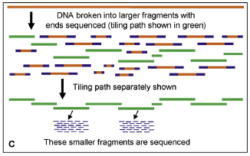
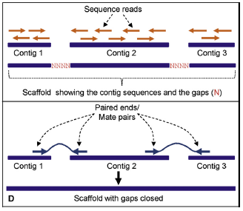
Sequencing Strategy
C) In the hierarchical shotgun sequencing approach, the chromosomes are sorted and broken into large fragments. Both ends of each clone are sequenced and the tiling path is determined based on sequence overlaps. The tiling path (shown as green fragments) is the smallest set of overlapping clones that covers the entire chromosome or contig. Once the clones in the tiling path are identified, the larger fragments in these clones are broken down into smaller fragments, which are then sequenced using a shotgun sequencing strategy. The sequence is put together by a sequence assembler.
D) A scaffold, or supercontig, is a portion of the chromosome (or genome) sequence that is composed of contigs put together in correct order. Scaffolds have gaps (upper panel); once the gaps are identified, the goal becomes sequencing those regions and closing the gaps. The lower panel shows that the scaffold of these three contigs is held together by mate pairs. The thin lines connect the paired ends.

Slide 5
Sequence Assembly
Sequence assembly can be done using one of three approaches:
(1) greedy,
(2) overlap-layout-consensus (OLC) and Hamiltonian path
(3) de Bruijn graph and Eulerian path

Slide 6
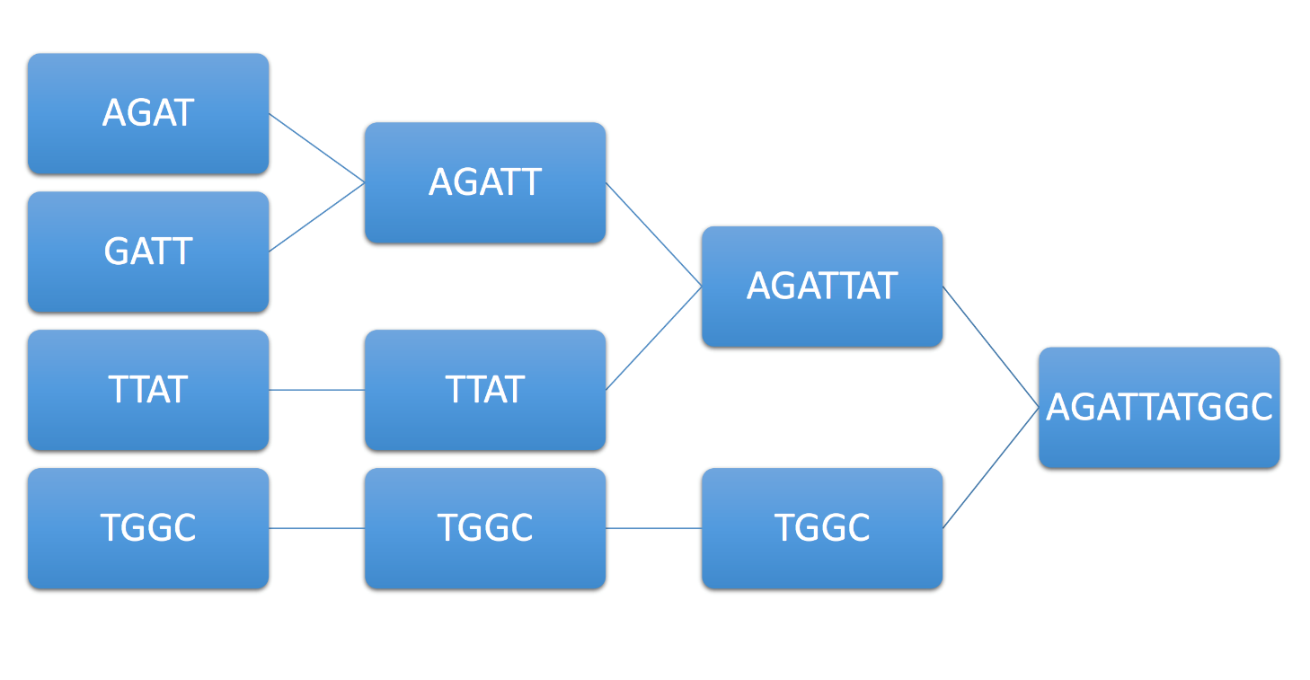
Greedy
First compares all fragments in a pairwise fashion to identify sequences that have overlaps
Next, the sequences that have the best overlaps are merged
this merging process continues until all the sequences with overlaps have been merged.
In this process, some reads may not be assembled, which are shown as gaps.
Paired-end sequencing is used to close the gaps

Slide 7
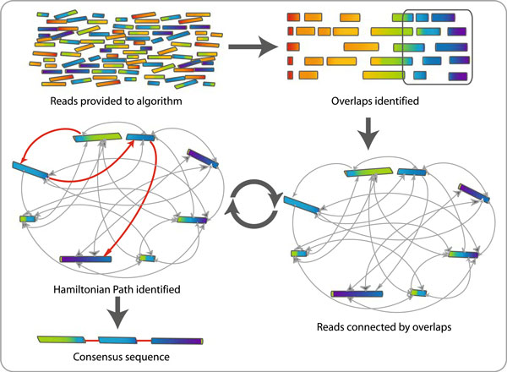
Overlap Layout Consensus and Hamilton Path
Based on all pairwise comparisons It generates a directed graph using reads and overlaps.
In the graph, each sequence is created as a node and an edge is created between any two nodes whose sequences overlap.
The algorithm then tries to find the Hamiltonian traversal path of the graph, which contains all the nodes (sequences) exactly once, and combines the overlapping sequences in the nodes into the sequence of the genome.

Slide 8
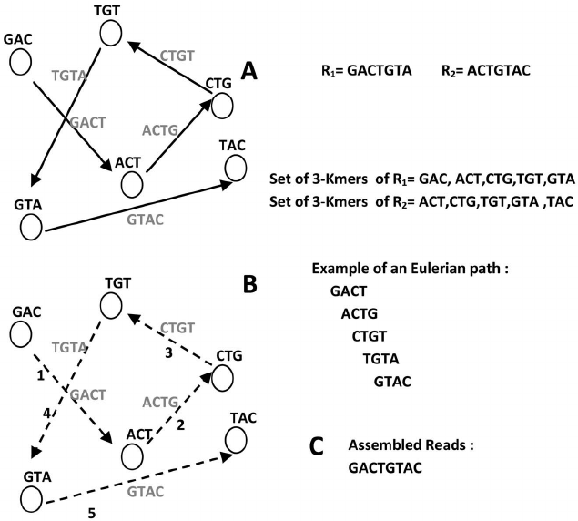
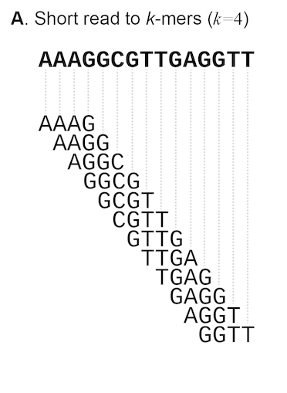
de Bruijn graph and Eulerian path
The de Bruijn graph does not use the actual sequence reads for assembly
It breaks each sequence read down to smaller sequences called k-mers.
These k-mers are aligned using (k-1) sequence overlaps.
The actual size of k depends on sequence coverage, read length, etc., but usually is not less than half of the actual read length.

Slide 9
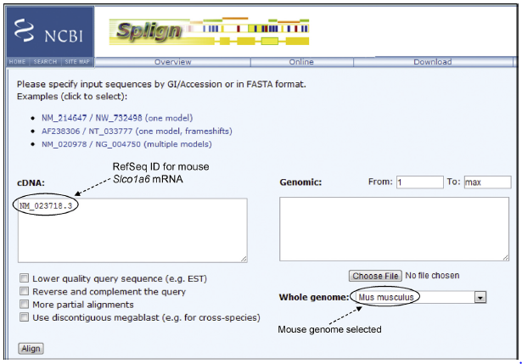
Genome Annotation
Genome annotation is the process by which biological information is assigned to the genome sequence. It involves:
Structural Aspect : the prediction of exons, introns, regulatory elements, various signal sequences, alternatively spliced variants, noncoding RNAs.
Functional Aspects: what type of gene product can be produced and their biological effects.
The example used is mouse Slco1a6 mRNA (cDNA) (RefSeq NM_023718.3). The goal is to map the sequence to and align it with the mouse genome to find the genomic location of the exons and splice-junction sites.

Slide 10
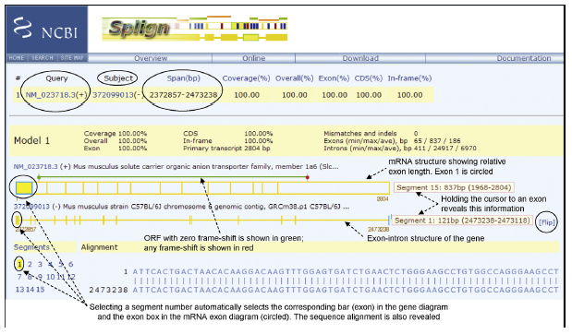
Gene Prediction

Slide 11
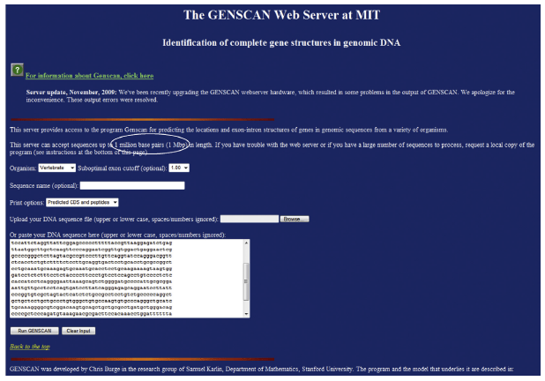
Gene Prediction

Slide 12
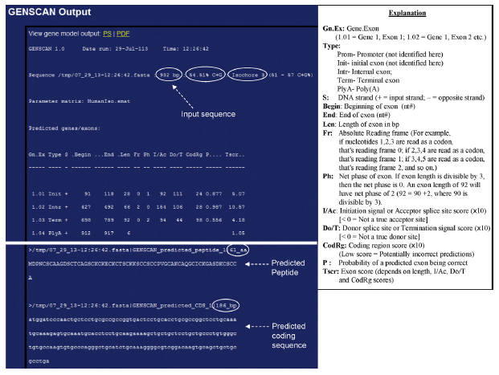

Slide 13
Prediction of Promoters
The promoter has two consensus sequences,
one at the-10 position (TATAAT in Escherichia coli), also known as the Pribnow box,
at the235 position (TTGACA in E. coli) relative to the transcription start site.

Slide 14
Kozak Sequence
R is a purine, which in most vertebrate mRNAs is an “A”
Most Prevalent base after “ATG”
5’-GCCRCCATGG-3’
Translation initiation codon

Slide 15
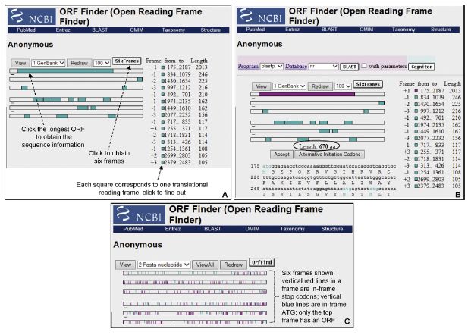

Slide 16
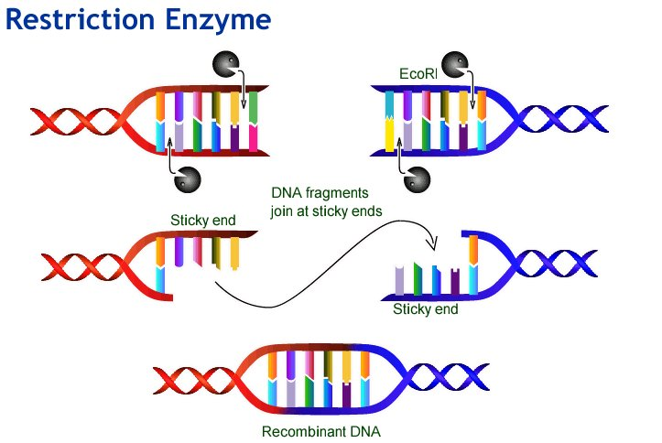
Restriction Mapping
Web Cutter 2: http://rna.lundberg.gu.se/cutter2/
NEBC Cutter 2.0: http://tools.neb.com/NEBcutter2/

Slide 17
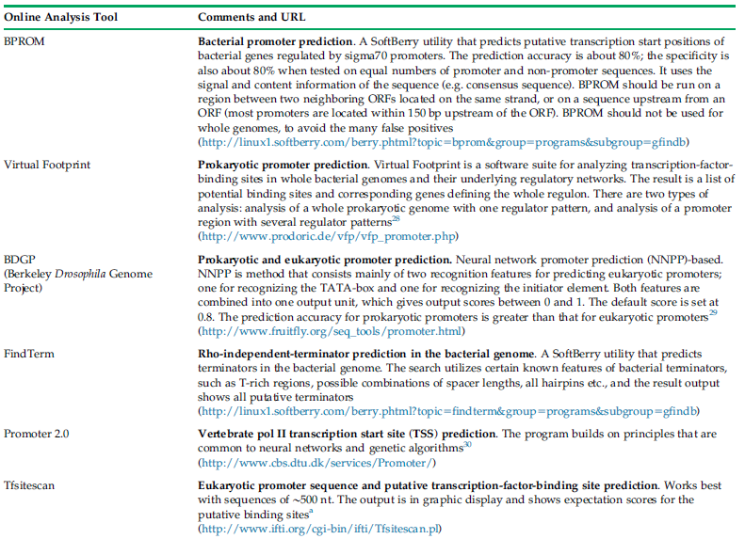

Slide 18
Detection of SNPs
A point mutation that occurs in at least 1% of the population is called an SNP.
They may occur at a frequency of 0.1% (1/1000 bases) in the genome.
More than 65% of all SNPs involve C to T transition mutation..
SNPs in the coding sequence can cause the alteration of the characteristics of the protein.
SNPs in the regulatory region can alter the expression level of the gene.

Slide 19
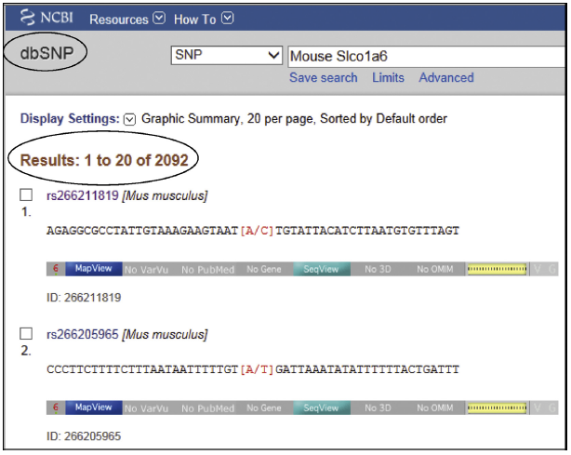

Slide 20
Thank You

